Slide 1


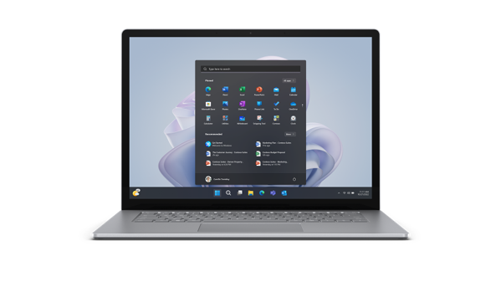


“Assured Buy Back” Program powered by XtraCover

Slide 2




Premiere Buyback Program that gives consumers FREEDOM to buy, enjoy and then sell Acer Laptops at an Assured Price within or outside Warranty
AvAcerable For:
SALIENT FEATURES
Get Assured Value
While Selling Your Laptop
Free Pickup
For Your Laptop at Your Convenient Address irrespective of original address on invoice
Instant Payment
Get Instant eVoucher , redeemable at
Acer eStore while making new purchase
Hassle Free Claims
Easy One-Call Pickup Scheduling System
Periodical value assessment via notification to Customer on the depreciated value of his Laptop

Slide 3
Assured BuyBack Value
Device Age
(From Date of Invoice)
(Device Value Excluding GST)
6 – 12 Months
70%
13 - 18 Months
60%
19 - 24 Months
50%
25 –30 Months
40%
31 – 36 Months
30%
37 – 48 Months
25%
49 to 60 Months
20%

Slide 4
Key Advantages for Acer India
Increase Repeated Transactions
More Frequent, Affordable Upgrades
Effective Recycling of Electronics
Reduced Carbon Footprint
Helps Acer in retaining Customers for repeat Purchase of Acer Laptop against the existing one from Acer eStore
Acer India gets payment from Xtracover on monthly basis against vouchers redeemed.

Slide 5





Customer Journey for BuyBack Guarantee
Brands / E-Commerce
Buy Device online from Acer eStore
Customer will select BBG Service along with the transaction.
Customer Visit XC Website via link to Register
Use Device for Up to BBG Covered Period
Raise Request by Calling / web of XC. Get Free Pickup & Instant eVoucher

Slide 6
General Terms
BBG card gives assurance of minimum buyback value at the time of purchase
You have to be the sole, absolute and lawful owner of the Device
Registration of device is mandatory once Buyback voucher is purchased.
The original box, invoice, & original accessories must be handed over at the time of claiming buyback
At the time of claiming buyback, the device must be in physically and functionally “OK” condition, valid tax invoice must be avAcerable, device age must be same or less than SIXTY (60) months and all the spares of the device must be original.
If any of the above mentioned criteria is void, still the customer will receive the eVoucher of the value as per best market rate.
Additional 5% depreciation on invoice value over and above the Buy back value will be applicable if the device is not in normal usage condition

Slide 7
COMMERICALS
Category | MRP | XC Selling Price | Taxes
Laptops | 499/- | 49/- | Excluded

Slide 8
BBG Sales (Date wise)
Sales Date | Qty Sold
12th Mar-25 | 3
13th Mar-25 | 1
17th Mar-25 | 2
20th Mar-25 | 1
TOTAL SALES | 7
Strategies for upscaling the sales number
Commercials for end customer is on higher side. Needs to be reduced.
BBG to be Hard-Bundled with Acer Laptops like Easy Carepacks.
Customer needs to know the benefits of BBG with bullet points at the time of purchase

Slide 9
Internal Process Between Acer & Xtracover
Acer shall share the BBG Sales data in mutually agreed format to Xtracover on regular basis
Xtracover shall share the details of Eligible Products registered for the BBG Plan (including the product details and customer details) on XTPL’s portal with Acer on monthly basis in the format as mutually agreed.
Acer shall provide a link in Acer eStore for Endusers to reach Xtracover website to register the BBG Plan
Acer may advertise, promote and market the BBG Plans as mutually agreed between the Parties
Xtracover shall buy discount vouchers from Acer on as and when required basis which will be given to the endusers (as per assured buyback value of their Acer Laptop) for future redeem purpose.
On monthly basis, Xtracover will share the Tax invoice to ACER on the basis of total sales of previous month and Acer will pay the amount to Xtracover as per agreement

Slide 10



